Slide 1
Welcome to
CS 235 Data Structures
Trees (BST) (27)
Chapter 8.3-4, pgs. 457-484

Slide 2
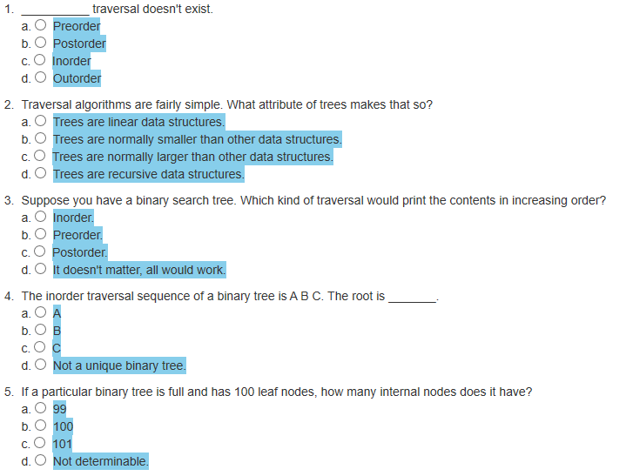
Attendance Quiz #26

Slide 3
Tip #27: Copying Objects
Containers hold objects, but not the ones you give them!
Instead, when you add an object to a container (via e.g., insert or push_back, etc.), what goes into the container is a copy of the object.
Once in a container, it's not uncommon for it to be copied further.
If your container resizes or shrinks, objects will be moved (copied) around.
If you insert something or erase something from a vector, string, or deque, existing container elements are typically moved (copied) around.
If you use any of the sorting algorithms, remove, unique, rotate or reverse, etc., objects will be moved (copied) around.
Copying objects is the STL way!
An object is copied by using it copying member function (ie., the copy constructor and its copy assignment operator).
Take away:
If you fill a container with objects where copying is expensive, the simple act of putting the objects into the container could prove to be a performance bottleneck.
The more things that get moved around in the container, the more memory and cycles you'll blow on making copies.

Slide 4
Less Copying
Consider the following standard swap implementation:
template <class T>
swap(T& a, T& b)
{
T tmp(a);
a = b;
b = tmp;
}
We now have 2 copies of a.
We have 2 copies of b plus all items in a are deleted.
That's 3 deep copies plus 3 deep deletions!
We now have 2 copies of tmp plus all items in b are deleted.
Finally, all items in tmp are deleted.
which is Ο(n), where n is the maximum number of objects in either a or b.
BUT, if the container has a swap method, you can do this:
firstItem.swap(secondItem);
which is Ο(1).
A vector has three internal pointers.
To swap two vectors, you only need to swap the three pointers.
The total cost is trivial compared to that of actually swapping the data in the vectors.
So whenever possible, use the container swap!

Slide 5
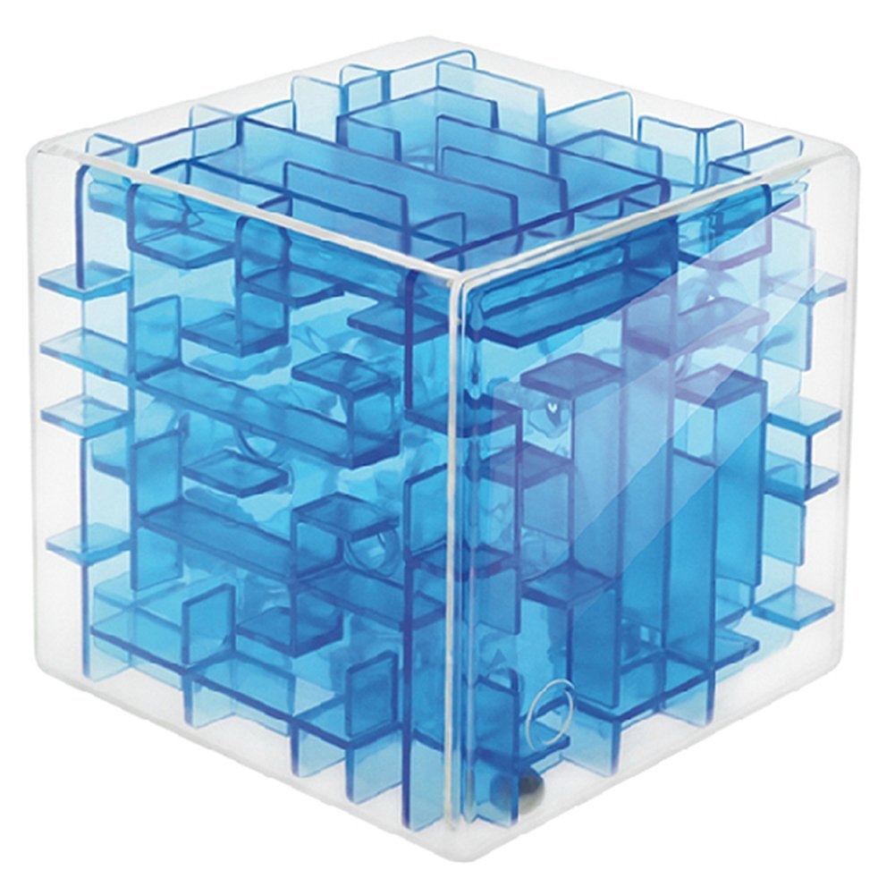
Lab 07 – 3D Maze

Slide 6
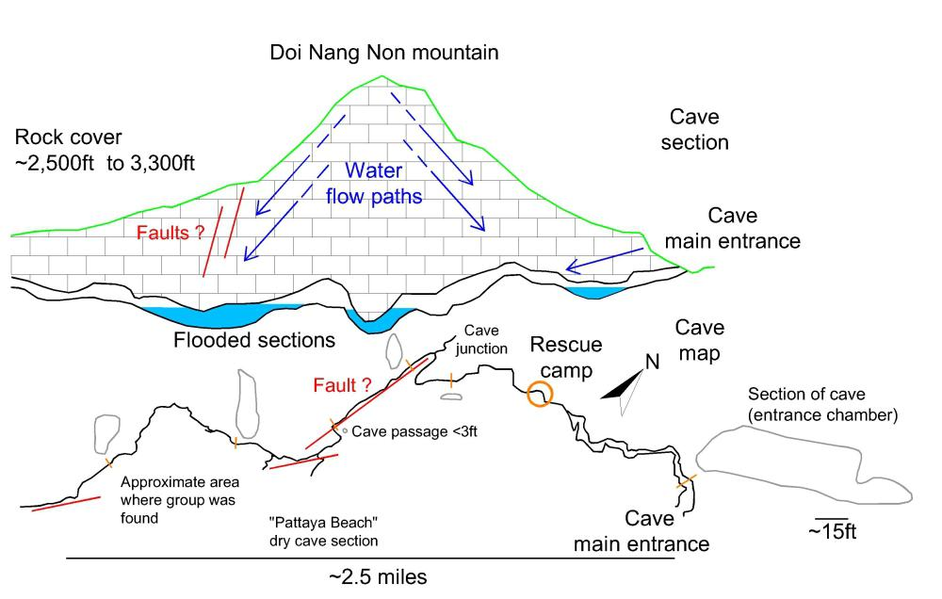
2018 Tham Luang Nang Non Cave Rescue

Slide 7
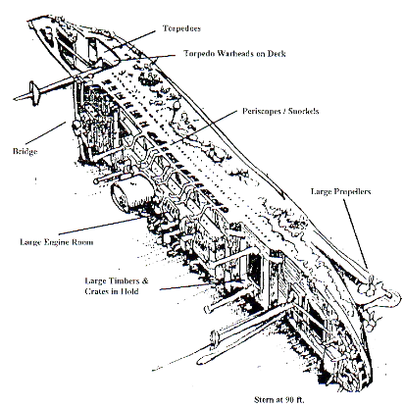
3D Maze
Two SCUBA diving buddies have encountered a large, box-shaped storage facility inside the hull of the Heian Maru, a 512' submarine tender lying on the bottom of Truk Lagoon at 108'.
The storage facility is composed of cells, some of which can be entered and some which cannot. The only exterior walls that are missing are on the front of
storage facility in the upper left corner, and on the rear of the storage facility in the lower right corner. The divers wish to determine a path through the storage facility.
Use backtracking to find a path through the maze or to prove that there is no path.

Slide 8
Finding a Path through a Maze
Problem
Use backtracking to find and display the path through a maze.
From each point in a maze you can move to an unblocked adjacent cell in a left, right, up, down, out, or in direction.
Analysis
The maze will consist of an array of cells.
The entry point is the top left corner (maze[0][0][0]) and the exit point is the bottom right corner (maze[height-1][width-1][layers-1]).
All cells will initially have an OPEN or BLOCKED value.
After exploring the maze, cell values will be one of the following:
Cells not visited will have an OPEN or BLOCKED value.
Cells not on the path that have been visited will have a VISITED value.
Cells on the path through the maze will have either a LEFT, RIGHT, UP, DOWN, OUT, or IN value.
The exit cell (if found) will have an EXIT value.

Slide 9
The Maze Layout
The maze size is defined by height × width × layer as specified on the first line of the test file.
4 4 4
0 0 0 0
0 1 1 1
0 1 1 1
0 1 1 1
0 0 0 1
1 1 1 1
1 1 1 1
0 1 1 1
0 0 1 0
0 1 1 0
0 1 1 1
0 1 1 1
1 0 1 1
1 0 1 1
1 0 1 1
1 0 0 0
Width
Left Right
Width
Left Right
START 0,0,0
START 0,0,0 | 0,1,0 | 0,2,0 | 0,3,0
1,0,0 | 1,1,0 | 1,2,0 | 1,3,0
2,0,0 | 2,1,0 | 2,2,0 | 2,3,0
3,0,0 | 3,1,0 | 3,2,0 | 3,3,0
0 (START) | 0 (Open) | 0 (Open) | 0 (Open)
0 (Open) | 1 (Blocked) | 1 (Blocked) | 1 (Blocked)
0 (Open) | 1 (Blocked) | 1 (Blocked) | 1 (Blocked)
0 (Open) | 1 (Blocked) | 1 (Blocked) | 1 (Blocked)
Layer
Out IN
Layer
Out IN
0,0,1 | 0,1,1 | 0,2,1 | 0,3,1
1,0,1 | 1,1,1 | 1,2,1 | 1,3,1
2,0,1 | 2,1,1 | 2,2,1 | 2,3,1
3,0,1 | 3,1,1 | 3,2,1 | 3,3,1
0 (Open) | 0 (Open) | 0 (Open) | 1 (Blocked)
1 (Blocked) | 1 (Blocked) | 1 (Blocked) | 1 (Blocked)
1 (Blocked) | 1 (Blocked) | 1 (Blocked) | 1 (Blocked)
0 (Open) | 1 (Blocked) | 1 (Blocked) | 1 (Blocked)
Height
Down Up
0,0,2 | 0,1,2 | 0,2,2 | 0,3,2
1,0,2 | 1,1,2 | 1,2,2 | 1,3,2
2,0,2 | 2,1,2 | 2,2,2 | 2,3,2
3,0,2 | 3,1,2 | 3,2,2 | 3,3,2
Height
Down Up
0 (Open) | 0 (Open) | 1 (Blocked) | 0 (Open)
0 (Open) | 1 (Blocked) | 1 (Blocked) | 0 (Open)
0 (Open) | 1 (Blocked) | 1 (Blocked) | 1 (Blocked)
0 (Open) | 1 (Blocked) | 1 (Blocked) | 1 (Blocked)
0,0,3 | 0,1,3 | 0,2,3 | 0,3,3
1,0,3 | 1,1,3 | 1,2,3 | 1,3,3
2,0,3 | 2,1,3 | 2,2,3 | 2,3,3
3,0,3 | 3,1,3 | 3,2,3 | EXIT 3,3,3
1 (Blocked) | 0 (Open) | 1 (Blocked) | 1 (Blocked)
1 (Blocked) | 0 (Open) | 1 (Blocked) | 1 (Blocked)
1 (Blocked) | 0 (Open) | 1 (Blocked) | 1 (Blocked)
1 (Blocked) | 0 (Open) | 0 (Open) | 0 (Exit)

Slide 10
Maze Values
The maze path is found recursively going Left, Right, Up, Down, Out, In.
Resulting maze values tell which way to proceed thru the maze.
Width
Left Right
5 (Right) | 5 (Right) | 8 (In) | 2 (Visited)
0 (Open) | 1 (Blocked) | 1 (Blocked) | 1 (Blocked)
0 (Open) | 1 (Blocked) | 1 (Blocked) | 1 (Blocked)
0 (Open) | 1 (Blocked) | 1 (Blocked) | 1 (Blocked)
Layer
Out IN
8 (In) | 4 (Left) | 4 (Left) | 1 (Blocked)
1 (Blocked) | 1 (Blocked) | 1 (Blocked) | 1 (Blocked)
1 (Blocked) | 1 (Blocked) | 1 (Blocked) | 1 (Blocked)
0 (Open) | 1 (Blocked) | 1 (Blocked) | 1 (Blocked)
Height
Down Up
5 (Right) | 8 (In) | 1 (Blocked) | 0 (Open)
0 (Open) | 1 (Blocked) | 1 (Blocked) | 0 (Open)
0 (Open) | 1 (Blocked) | 1 (Blocked) | 1 (Blocked)
0 (Open) | 1 (Blocked) | 1 (Blocked) | 1 (Blocked)
1 (Blocked) | 7 (Down) | 1 (Blocked) | 1 (Blocked)
1 (Blocked) | 7 (Down) | 1 (Blocked) | 1 (Blocked)
1 (Blocked) | 7 (Down) | 1 (Blocked) | 1 (Blocked)
1 (Blocked) | 5 (Right) | 5 (Right) | 3 (Exit)

Slide 11
Maze Values
The maze path is found recursively going Left, Right, Up, Down, Out, In.
Resulting maze values tell which way to proceed thru the maze.
Width
Left Right
R (Right) | R (Right) | I (In) | * (Visited)
_ (Open) | X (Blocked) | X (Blocked) | X (Blocked)
_ (Open) | X (Blocked) | X (Blocked) | X (Blocked)
_ (Open) | X (Blocked) | X (Blocked) | X (Blocked)
Layer
Out IN
I (In) | L (Left) | L (Left) | X (Blocked)
X (Blocked) | X (Blocked) | X (Blocked) | X (Blocked)
X (Blocked) | X (Blocked) | X (Blocked) | X (Blocked)
_ (Open) | X (Blocked) | X (Blocked) | X (Blocked)
Height
Down Up
R (Right) | I (In) | X (Blocked) | _ (Open)
_ (Open) | X (Blocked) | X (Blocked) | _ (Open)
_ (Open) | X (Blocked) | X (Blocked) | X (Blocked)
_ (Open) | X (Blocked) | X (Blocked) | X (Blocked)
X (Blocked) | D (Down) | X (Blocked) | X (Blocked)
X (Blocked) | D (Down) | X (Blocked) | X (Blocked)
X (Blocked) | D (Down) | X (Blocked) | X (Blocked)
X (Blocked) | R (Right) | R (Right) | E (Exit)

Slide 12
Dynamic Arrays
A dynamic array is basically an array of pointers to arrays. A 2-dimensional dynamic array is created/deleted using a loop as follows:
int height = 10;
int width = 10;
int **myArray = new int*[height];
for(int i = 0; i < height; ++i)
{
myArray[i] = new int[width];
}
Constructor
for(int i = 0; i < height; ++i)
{
delete [] myArray[i];
}
delete [] myArray;
Destructor

Slide 13
The 3D Maze Array
The 3D maze array is of data type "int***" - a pointer to a pointer to a pointer to an int.
int**
int*
int
int*** maze_
int maze[3][2][2]
maze[1][0][1]

Slide 14
2D Implementation
bool find_maze_path(int height, int width)
{
if ( cell out of bounds... )
return false; // out of bounds (base case #1)
if ( cell not open... )
return false; // blocked (base case #2)
if ( exit cell... )
{
maze_[height][width] = EXIT; // success! (base case #3)
return true;
}
// NOTE: not the search pattern used for 3d solutions
maze_[height][width] = PATH; // possible path, try all paths
if (find_maze_path( up... ) || // check up
find_maze_path( down... ) || // check down
find_maze_path( left... ) || // check left
find_maze_path( right... ) ) // check right
return true; // one of the paths works
maze_[height][width] = VISITED; // none work, don’t visit again
return false;
}

Slide 15
Requirements
Points | Requirement (45 + 8 Points)
10 | Backtracking used to correctly solve a 4 x 4 x 4 maze (lab07_in_01.txt).
10 | Backtracking used to correctly solve a 5 x 5 x 5 maze (lab07_in_02.txt).
10 | Backtracking used to correctly solve a 5 x 10 x 6 maze (lab07_in_02.txt).
10 | Backtracking used to correctly solve a large maze.
10 | Your Maze program uses backtracking to detect an unsolvable maze (lab07_in_05.txt).
-10 | Memory Leaks, array out-of-bounds, STL containers in any test.
Points | Peer Review
2 | A Maze class contains a dynamically sized 3-dimensional maze array as specified by the first line of the input file.
2 | The Maze class is derived from the abstract MazeInterface interface class. No STL container is used anywhere in your Maze class.
2 | The Maze toString() function returns a formatted string of the maze (as described above.)

Slide 16
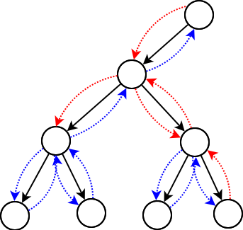
8.3 Implementing a Binary_Tree Class
8.4 Binary Search Tree
Chapter 8 – Binary Search Tree

Slide 17
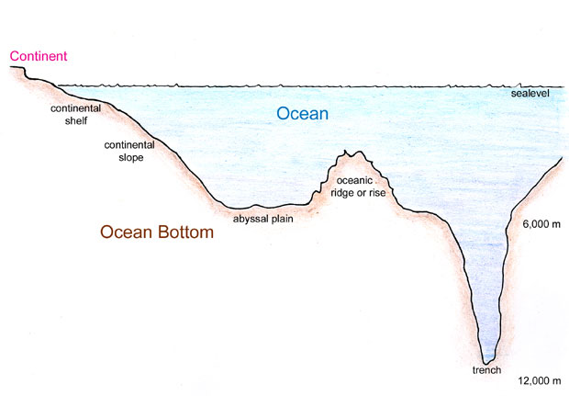
Tree Terminology Summary
Node (Vertex)
Branch (Edge)
Height: 4
Depth: 0
Level: 1
Height: 2
Depth: 1
Level: 2
Height: 3
Depth: 1
Level: 2
Depth
Height
Height: 1
Depth: 2
Level: 3
Height: 1
Depth: 2
Level: 3
Height: 2
Depth: 2
Level: 3
Height: 1
Depth: 3
Level: 4
Root Node
Internal Node
Root node is depth 0
Leaf nodes are height 1
Leaf Node

Slide 18
Traversal
pre_order_traversal(node)
if node is NULL return
visit node
pre_order_traversal(node.left)
return pre_order_traversal(node.right)
Full tree
internal nodes w/2 children
Complete tree
unfilled nodes right on level h
Predecessor
left, right-most node
Successor
right, left-most node
in_order_traversal(node)
if node is NULL return
in_order_traversal(node.left)
visit node
return in_order_traversal(node.right)
8
4
12
post_order_traversal(node)
if node is NULL return
post_order_traversal(node.left)
post_order_traversal(node.right)
visit node
return
2
6
10
14
1
3
5
7
9
11
13

Slide 19
Tree Traversal
Level-order:
In-order:
Pre-order:
Post-order:
8
4
12
2
6
10
14
8
Level-order:
In-order:
Pre-order:
Post-order:
4
12
2
6
10
14
1
3
5
7

Slide 20
Tree Traversal
8
4
12
2
6
10
14
Level-order:
In-order:
Pre-order:
Post-order:
8
2
4
6
8
10
12
14
4
12
8
4
2
6
12
10
14
2
6
10
14
2
6
4
10
14
12
8
8
4
12
2
6
10
14
1
3
5
7
8
Level-order:
In-order:
Pre-order:
Post-order:
1
2
3
4
5
6
7
8
10
12
14
4
12
8
4
2
1
3
6
5
7
12
10
14
2
6
10
14
1
3
2
5
7
6
4
10
14
12
8
1
3
5
7

Slide 21
8.3 Implementing a Binary_Tree Class
The BTNode Class
The Binary_Tree Class
Copy Constructor, Assignment, and Destructor
8.2, pgs. 457-465

Slide 22
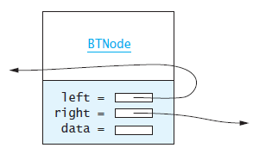
The BTNode Class
#ifndef BTNODE_H
#define BTNODE_H
#include <sstream>
using namespace std;
/** A node for a Binary Tree. */
template<typename T>
struct BTNode
{
T data;
BTNode* left;
BTNode* right;
BTNode(const T& d, BTNode* l = NULL, BTNode* r = NULL) :
data(d), left(l), right(r) {}
~BTNode() = default;
string toString() const
{
ostringstream os;
os << data;
return os.str();
}
friend ostream& operator<<(ostream& out, const BTNode<T>& node)
{
return out << node.toString();
}
}; // end BTNode
#endif // BTNODE_H
Like a linked list, a node consists of a data part and links to successor nodes.
So that we can store any kind of data in a tree node, we make the data part an object of type T.
A binary tree node must have links (pointers) to both its left and right subtrees.

Slide 23
8.4 Binary Search Trees
Overview of a Binary Search Tree
Performance
The Binary_Search_Tree Class
Insertion into a Binary Search Tree
Removal from a Binary Search Tree
8.2, pgs. 457-465

Slide 24
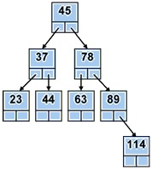
Binary Search Tree
"A Binary Search Tree (sometimes called an ordered or sorted binary tree) is a node-based data structure where each node references a value, a left child, and a right child.
In a Binary Search Tree (BST)
the left subtree of a node contains only nodes with values less than the node's value,
the right subtree of a node contains only nodes with values greater than the node's value,
there are no duplicate nodes,
and both left and right subtrees of a node must also be binary search trees.

Slide 25
Search
bool search(node, value)
if node is NULL
return false
if node.value == value
return true
if value < node.value
return search(node.left, value)
search(node.right, value)
8
Find node 9
4
12
Go right
Go left
2
6
10
14
Go left
1
3
5
7
9
11
13
15

Slide 26
Insert
bool insert(Node*& node, const T& data)
if node is NULL
node = new Node(data)
return true
if data == node->data
return false
if data < node->data
return insert(node->left, data);
return insert(node->right, data);
8
8
8
Insert node 6
Go left
Insert as 4's right child
4
4
4
12
12
12
2
2
2
6
6
10
10
10
14
14
14
Insert node 13
Go right, right
Insert as 14's leftchild
1
1
1
3
3
3
11
11
13
15
15
15

Slide 27
Insert
40
8
45
Insert node 38
Insert node 35
Insert node 80
Insert node 2
Insert node 3
5
34
42
55
14
48
75
13
20
47
49

Slide 28
Delete
bool delete(Node*& node, const T& data)
if node is NULL, return false
if data < node->data, return delete(node->left, data)
if data > node->data, return delete(node->right, data)
if node has no children, parent = NULL, return true
if node has 1 child, parent = node->(left or right), return true
exchange node->data with in_order_predecessor->data
return delete(node->left, data)
8
8
8
8
8
8
8
Delete node 2
Find node (2)
Set parent (3) to child (1)
8
3
3
3
3
9
9
9
3
9
3
3
3
9
9
9
9
2
2
2
2
4
4
4
2
5
2
2
1
4
4
4
5
12
12
12
12
12
12
12
12
1
11
11
11
11
11
11
11
4
11
4

Slide 29
Delete
bool delete(Node*& node, const T& data)
if node is NULL, return false
if data < node->data, return delete(node->left, data)
if data > node->data, return delete(node->right, data)
if node has no children, parent = NULL, return true
if node has 1 child, parent = node->(left or right), return true
exchange node->data with in_order_predecessor->data
return delete(node->left, data)
5
8
8
8
8
8
5
8
Delete node 2
Find node (2)
Set parent (3) to child (1)
8
3
3
3
3
3
3
3
3
9
9
9
9
9
9
9
Swap data
9
Delete node 8
Find predecessor (5)
Exchange data only with node
Delete 8 from left tree
2
2
2
2
2
1
2
1
4
4
4
4
4
4
4
5
8
12
12
12
12
12
12
12
12
11
11
11
11
11
11
11
4
11

Slide 30
Delete node 8
Delete node 17
8
12
6
4
Swap data
12
4
22
2
6
2
17
8
1
5
7
1
16
20
Delete node 40
Delete node 40
40
40
4
45
4
45
3
34
42
55
3
20
42
55
14
48
75
15
34
48
13
15
47
49
25
47
49

Slide 31
Balanced Binary Search Trees
The performance of a binary search tree is proportional to the height of the tree or the maximum number of nodes along a path from the root to a leaf.
A full binary tree of height h (assuming an empty tree is of height 0,) can hold 2^{h} -1 items.
If a binary search tree is full and contains n items, the expected performance is O(log n).
However, if a binary tree is not full, the actual performance is worse than expected, possibly up to O(n).
Self-balancing trees require the heights of the right and left subtrees to be equal or nearly equal.
We'll examine these trees later as well as non-binary search trees: the B-tree and its specializations, the 2-3 and 2-3-4 trees, and the B+ tree.

Slide 32
Be Safe

